Slide 1
Using the Pen Tool in Illustrator
NAIT - COMP1008

Slide 2
The Pen Tool
If you are using Adobe Illustrator you will most likely be utilizing the pen tool. The pen tool is probably one of Adobe’s most essential tools.
The pen tool creates paths made up of anchor points. Everytime you click your mouse/trackpad you will create an anchor point.
Using the pen tool, you can create straight line segments or by clicking and dragging and drawing to a new point you can create a bezier curve.
The pen tool will also allow you to create, remove and convert anchor points.

Slide 3
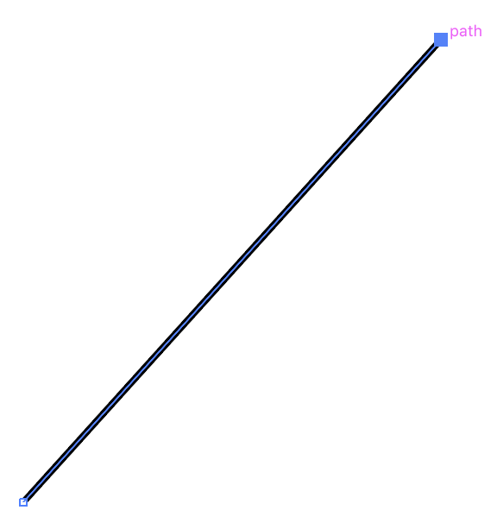
Anchor Points
Anchor Point
Anchor points are created when you click your mouse/trackpad while using the pen tool. Everytime you click your mouse/trackpad you are creating anchor points(also known as nodes).
Anchor points are represented as squares along a path. You can easily create more, remove points and convert them between straight and Bezier curves.
Path
Starting Anchor Point

Slide 4
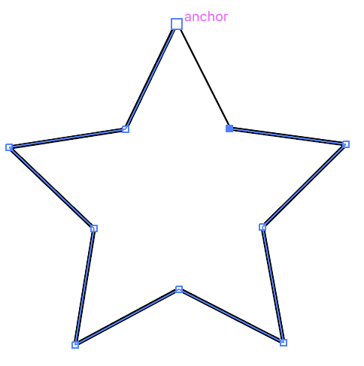
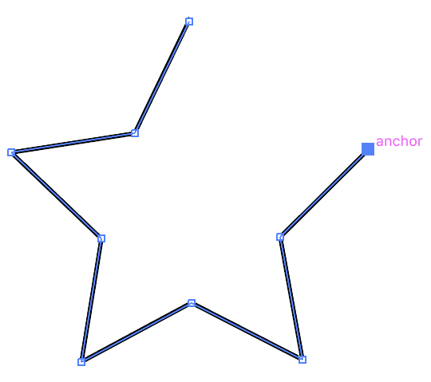
The Pen Tool: line segments
Anchor Point - created each time you click your mouse/trackpad
Completed line segment

Slide 5
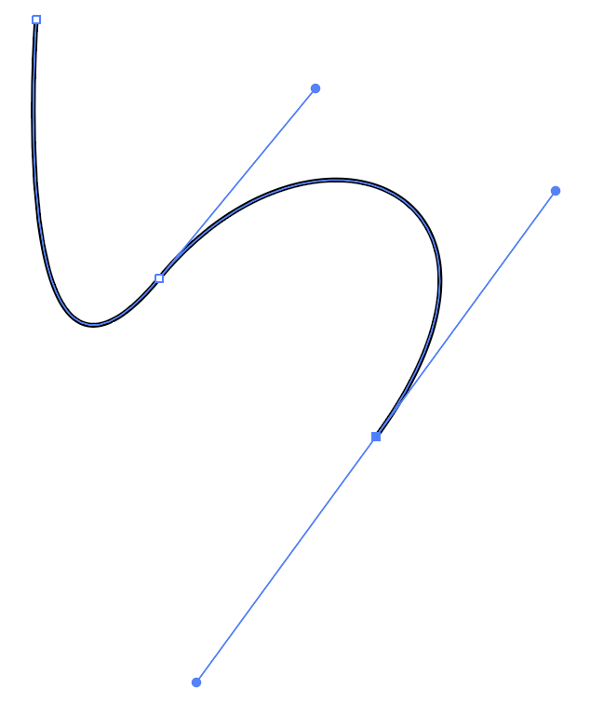
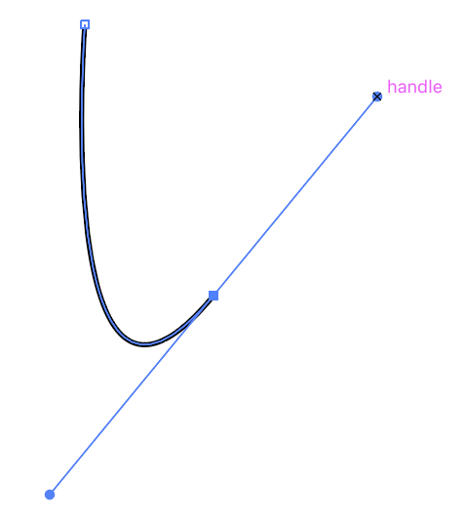
Pen Tool: bezier curves
To create the bezier curve(s) start by selecting your pen tool (p).
Position the pen on your artboard where you want the curve to begin and create your first anchor point.
When you clikc your mouse, continue to hold it down and drag your mouse to set the slope of the curve you want, release your mouse. As you are drawing your line you will see two light blue lines as you draw your third node. Those lines are called handles. The handles will create the shape you want to achieve.
handles

Slide 6
Bezier curves
The bezier curves handles control two things:
They control the angle of the curve.
And they control the length of the curve.
The further you drag your point, the longer the handle, the longer/larger the curve.
Rotating the curve:
Select the direct selection tool (or hold ctrl/cmd) and click on the handle point and rotate. Holding down shift will allow you select specific degree points. You will notice that both handles rotate.
handles

Slide 7
Bezier curves
Rotate handles independently
Rotate handles independently of each other: hold down the Alt/Option key and click on handle that you wish to rotate and drag. Once you’ve started to move your handle you can release the alt/option key.
Resizing Curves:
If you are trying to resize the curve, each curve will have to resized independently. You cannot resize multiple curves at once.
handles

Slide 8
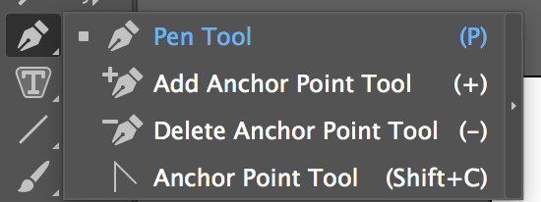
Creating & Removing Anchor Points
You can create (add) or remove (delete) anchor points from any vector object, where it’s a square, circle, path you’ve created. You do need to have your pen selected to use these options initially.
Select the item you want to edit, and click on the pen tool in your tools palette or click the letter P on your keyboard.
Select either add or delete anchor point tool.
Edit your path or shape. It’s that simple!

Slide 9


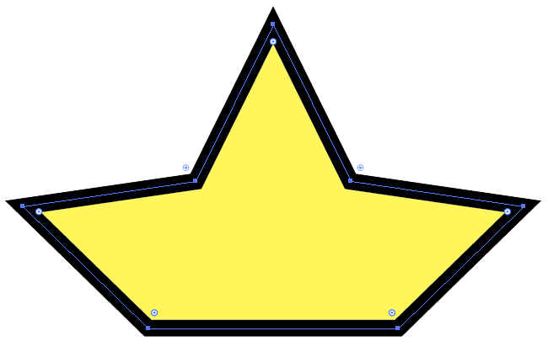
Creating & Removing Anchor Points - Examples
Original shape - with original anchor points
Original shape - with anchor points added
Anchor points were removed - changing the the shape.
You can create or remove as many anchor points as you wish on a path/shape, however the more anchor points you have may lead have unsmooth paths/edges of your shapes and it may create more work for you!
Try to keep your anchor points to a minimum if possible!

Slide 10

Using the direct selection tool
In Illustrator you have two selection tools at the top of your toolbar. The one on the left is your “selection” tool used to select items and move them around on your page. The one of the right is “direct selection” tool, this will allow you edit your shapes/paths to create new shapes/paths and allows you move your anchor points around.
Direct Selection Tool (A)
You can also bring up your direct selection tool, but selecting your shape/path with your normal selection tool (v) and hovering over an anchor hold down ctrl/cmd (you should see a white arrow). Click on the node and hold and drag it around to move it around.
Selection Tool (V)

Slide 11
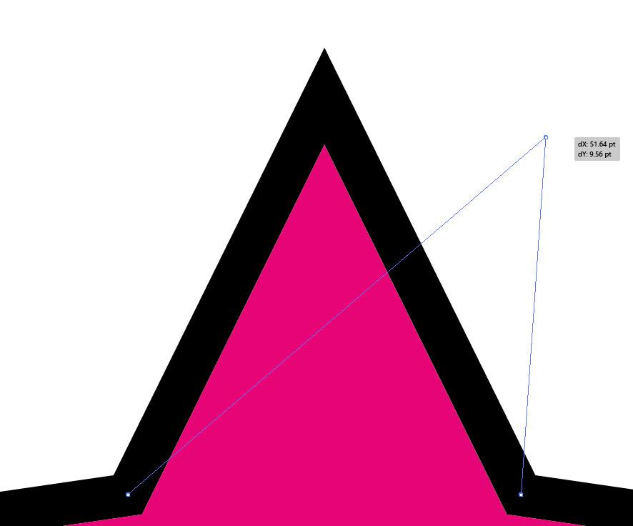

Using the direct selection tool
Using the direct selection (A) to move an anchor point

Slide 12
Converting Anchor Points
When creating paths/shapes you can convert your anchor points to create either sharp 90° corners (no handles) or bezier shapes (with handles).
There are two ways to convert your anchors points:
Using the Anchor Point Tool (Shift + C) and clicking the specified point.
With your object selected, using the direct selection tool (A), select a point on your path and use the convert tools in the menu bar (below the root menu)

Slide 13



Converting Anchor Points - Examples
handles
Converting to a bezier curve. Notice how the sharp points don’t have handles.
Converting a bezier curve to a sharp corner.

Slide 14
Sources
Sources:
https://bezier.method.ac/
https://helpx.adobe.com/ca/illustrator/how-to/pen-tool-exercises.html
https://helpx.adobe.com/illustrator/using/drawing-pen-curvature-or-pencil.html
https://design.tutsplus.com/tutorials/illustrators-pen-tool-the-comprehensive-guide--vector-141
https://lynda.com
https://digitalsynopsis.com/design/adobe-illustrator-pen-tool-tips/

